Slide 1

Rechnerarchitekturen für Deep-Learning Anwendungen (RADL)
Dustin Heither, Maximilian Achenbach, and Robert Kagan
Optimizing Deep Learning Performance:
A Hybrid CPU-GPU Framework with Multithreading, SIMD,
and Evaluation of Efficiency Metrics

Slide 2
Outline
2. Presentation
01
Multithreading
02
Hardware
03
Benchmarks
04
CUDA tuning
05
Outlook

Slide 3

Multithreading
Goal
Multithreading has been implemented to optimize the performance of these functions:
tf.h:
matrix *add(matrix *a, matrix *b);
matrix **biasing(matrix **a, int len, matrix *b);
matrix **conv2d(matrix *a, matrix **b, int len);
matrix *flatten(matrix **a, int len);
matrix **flip_kernels(matrix **a, int len);
matrix **hyperbolic_tangent(matrix **a, int len);
matrix *matmul(matrix *a, matrix *b);
matrix **maxpool(matrix **a, int len);
matrix **relu(matrix **a, int len);
matrix *transpose(matrix *a);
mt.h:
void add_mt(mt_arg *mt);
void biasing_mt(mt_arg *mt);
void conv2d_mt(mt_arg *mt);
void flatten_mt(mt_arg *mt);
void flip_kernels_mt(mt_arg *mt);
void hyperbolic_tangent_mt(mt_arg *mt);
void matmul_mt(mt_arg *mt);
void maxpool_mt(mt_arg *mt);
void relu_mt(mt_arg *mt);
void transpose_mt(mt_arg *mt);

Slide 4
Multithreading
Implementation
We have implemented the following struct to be passed to the pthreads:
mt.h:
typedef struct mt_arg {
long idx;
matrix **a_ptr;
matrix *a;
matrix **b_ptr;
matrix *b;
int len;
matrix **c_ptr;
matrix *c;
int m;
void (*start_routine)(struct mt_arg *mt);
} mt_arg;
We have developed a proof of concept:
Each function independently created and joined its own pthreads
The implementation was functional
However, performance was suboptimal

Slide 5
Multithreading
Thread pool
We have implemented a thread pool:
Thanks to the suggeestion of Philipp Holzinger :)
Threads are now:
Created once at the start using the function:
void create_mt(long threads);
Joined once at the end using the function:
void join_mt();
Implementation:
Utilizes a GAsyncQueue for task management
The threads execute the followoing function:
static void *start_mt(void *arg);
Thread behavior:
The threads wait for elements to be added to the queue
Upon receiving an element, they execute the provided function with its associated parameters
This process repeates indefinetly
Elements can be added to the queue with:
void push_mt(mt_arg *mt);
void join_mt(); adds a termination signal to the queue by pushing the function:
static void stop_mt(mt_arg *mt);
This ensures that all threads exit cleanly and can be joined properly

Slide 6
Multithreading
Challenges
A race condition was identified and debugging it required significant effort:
To address this, a synchronization barrier was implemented using the function:
void wait_mt();
This implementation required an understanding of pthread_cond_t and pthread_mutex_t
Testing improvements:
The existing dataset (MNIST) was determined to be too small for thorough testing
A larger test set was created by applying a scale factor of 20, resulting in image dimensions of (30x20)²
Concurrency research and evalutaton:
Various concurrency solutions were analyzed for suitability
Fork:
Duplicates the calling process
Offers low flexibility and incurs high overhead
Pthreads:
The current solution being used
Provides full control over concurrency
OpenMP:
A compiler-based concurrency implememtation
Offers lower control
We plan to explore its implementation in the upcoming weeks

Slide 7
Hardware
Overview
CPU | Release dates | TDP (W) | Number of (performance) cores | Number of threads
AMD Ryzen 7 3800XT | 7. Juli 2020 | 105 | 8 | 16
Apple M3 Pro 11-Core | 30. Oktober 2023 | 27 | 5 | 11
Intel Core i7 1065G7 | 1. Juni 2019 | 15 | 4 | 8

Slide 8
Benchmark
Overview
Batch size: 1
Epochs: 128
Overhead:
In microseconds (µs)
Averaged over 10 runs
Sum of:
void create_mt(long threads);
void join_mt();
Performance:
In microseconds (µs)
Averaged over 10 runs
Total time
XL:
In microseconds (µs)
Averaged over 10 runs
Image dimensions of (30x20)²

Slide 9
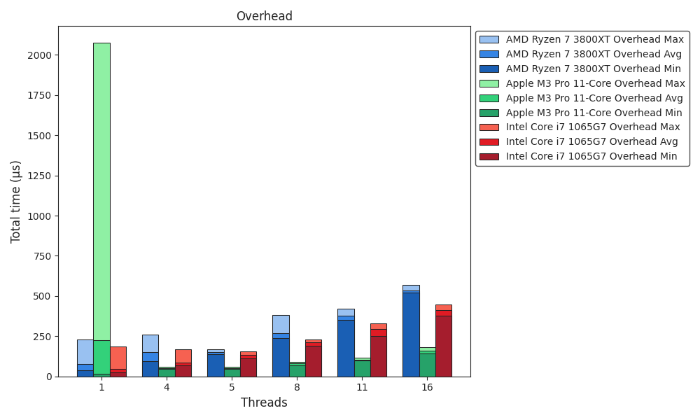
Benchmark
Overhead

Slide 10
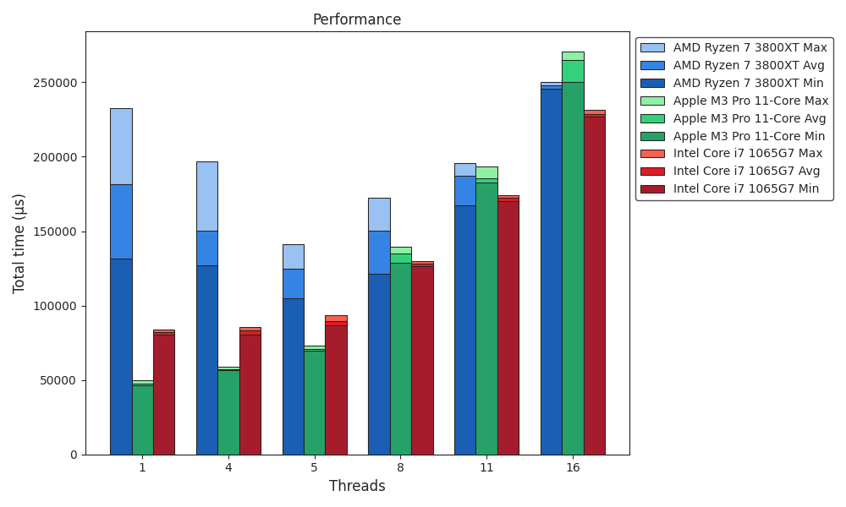
Benchmark
Performance

Slide 11
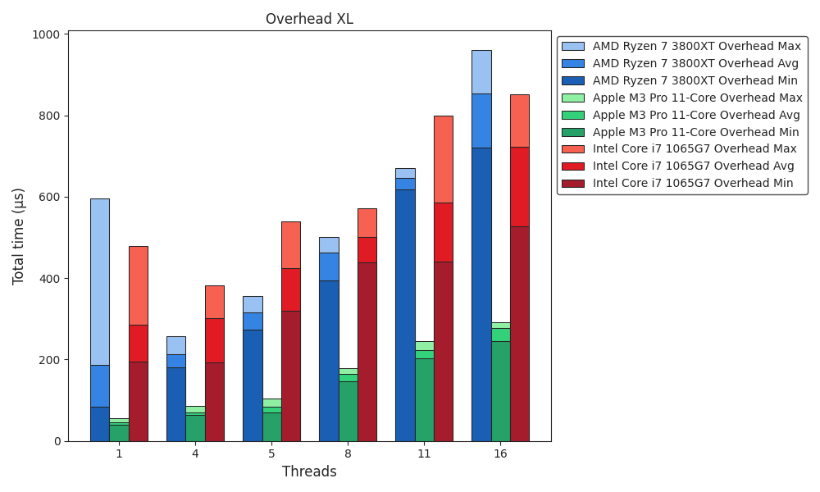
Benchmark
Overhead XL

Slide 12
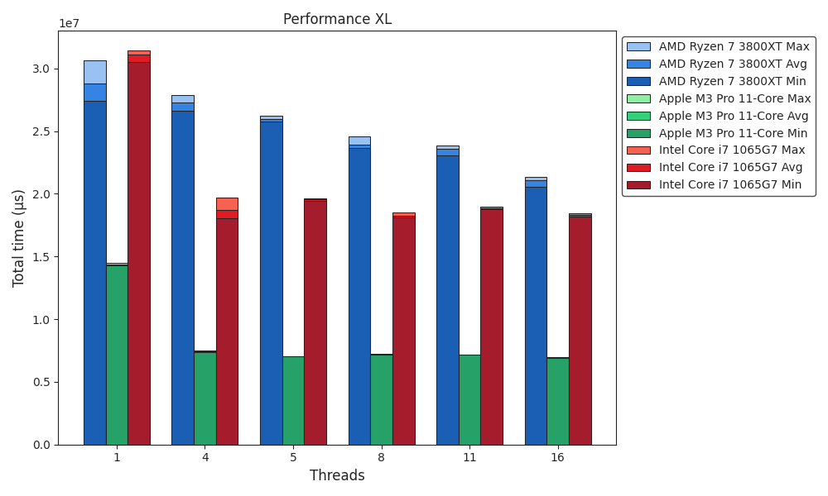
Benchmark
Performance XL

Slide 13
Benchmark
ICX vs. GCC
ICX:
Intel oneAPI DPC++/C++ Compiler
Part of Intel oneAPI
Formerly Intel C Compiler (ICC)
Available for Windows and Linux
macOS, thus Apple, is not supported
→ could not be benchmarked
Supports threading via Intel oneAPI Threading Building Blocks, OpenMP, and native threads
Both: -O3 optimization flag → turns on all optimizations
(We tested the flag for accuracy and it passed)
GCC:
GNU Compiler Collection
Available for Windows, Linux, macOS, and a lot more
Supports threading via OpenMP, native threads, and OpenACC

Slide 14
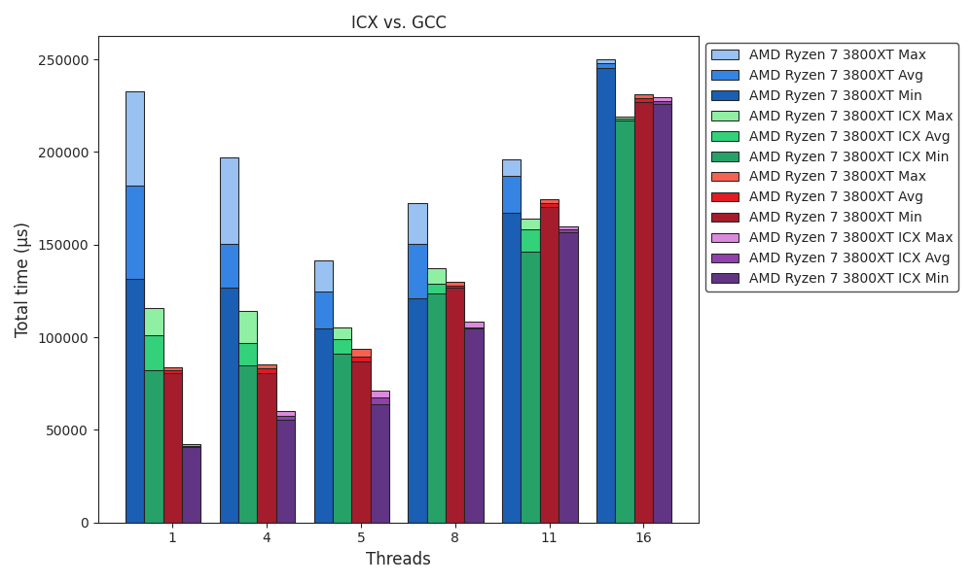
Benchmark
ICX vs. GCC

Slide 15
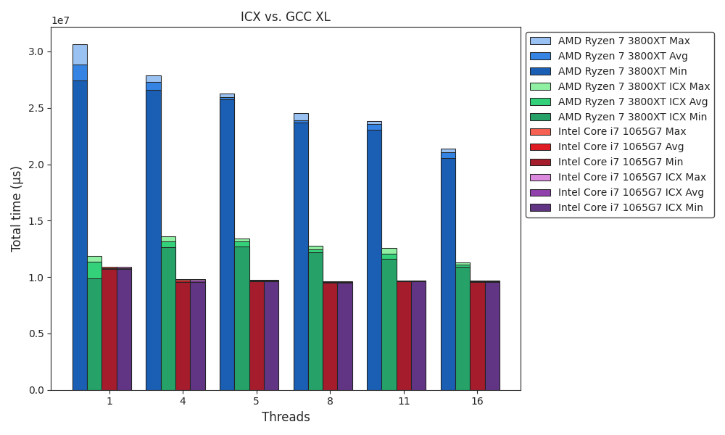
Benchmark
ICX vs. GCC XL

Slide 16
CUDA tuning
First steps
Implemented matrix multiplication with CUDA in a sandboxed environment
First insights:
For our problem size (MNIST), GPU computation takes significantly longer than CPU
206.417µs vs. 2.282µs
Reason: Data transfer overhead between CPU and GPU memory dominates computation time
Difficulties encountered:
Compiling CUDA C++ correctly within our framework, which is written in C
The extern "C" declaration in the .c files is not functioning as expected
Using gcc to compile the .c files
Using nvcc to compile the .cu files
Linking all components together with nvcc

Slide 17
Outlook
Work in progress
Framework ✔
Multithreading ✔️
(Implementing OpenMP and comparing its performance to the current solution)
ICX vs. GCC ✔️
SIMD
Arm Neon
SSE vs. AVX2 vs. AVX-512
Quantization
CUDA tuning
Matrix multiplication ✔
(Apple M3 Pro NPU)

